Slide 1
2018 SHOW-IT CATEGORY
<Your App Name>

Slide 2
<Your App Name>: Overview
Briefly summarize your app. What problem does it solve or what need does it meet? What are its key features?
<Your answer here…>
Which of the eight challenges did you choose, and how does your app address that challenge?
<Your answer here…>

Slide 3
<App Name>: Marketing
Define the target market for your app. You may include factors such as age, sex, geographic location, and others.
<Your answer here…>
What makes your app unique? Why should people use your app instead of another app that meets a similar need?
<Your answer here…>

Slide 4
<App Name>: Technology
What platform will your app be built for and why?
<Your answer here…>
What technologies will your app take advantage of? For example, will it use GPS to provide real-time location information? Will it interface with any data sources?
<Your answer here…>

Slide 5
<App Name>: User Experience
What assumptions, if any, does your app make about its users?
<Your answer here…>
What kind of training, if any, will people need to use your app?
<Your answer here…>

Slide 6
<App Name>: Screen Mockups
On the following pages, provide mockups of screens that show how your app will work. These should include, but are not limited to:
Login screen (if applicable)
Main screen
App feature 1
Workflow step A
Workflow step B
Workflow step C
App feature 2
Workflow step A
Workflow step B
Workflow step C

Slide 7
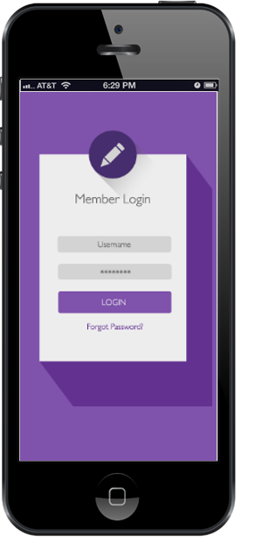
Login Screen (if applicable)
<Brief description>

Slide 8
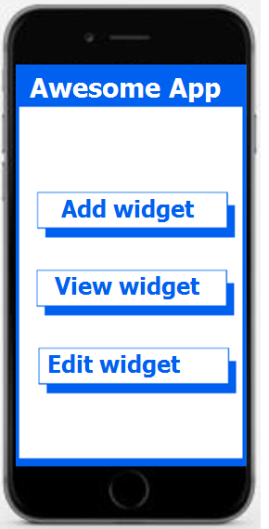
Main screen
<Brief description>

Slide 9
App feature 1
Workflow Step A
<Describe the workflow for this feature. Show screens for each step within the workflow.>

Slide 10
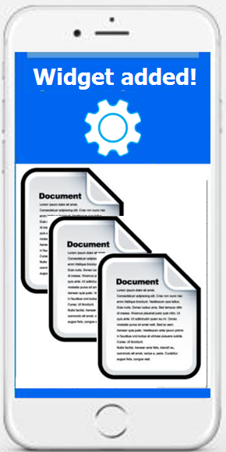
App feature 1
Workflow Step B
<Describe the workflow for this feature. Show screens for each step within the workflow.>

Slide 11
App feature 1
Workflow Step C
<Describe the workflow for this feature. Show screens for each step within the workflow.>

Slide 12
App feature 2
Workflow Step A
<Describe the workflow for this feature. Show screens for each step within the workflow.>

Slide 13
App feature 2
Workflow Step B
<Describe the workflow for this feature. Show screens for each step within the workflow.>

Slide 14
App feature 2
Workflow Step C
<Describe the workflow for this feature. Show screens for each step within the workflow.>

